Slide 1
Agile Engineering Practices

Slide 2
Better: When is Quality?
Plan/Manage
LEGO
Dev
Fun
Core
Origins
Intro
Agenda

Slide 3
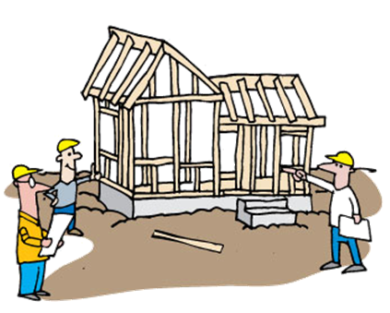
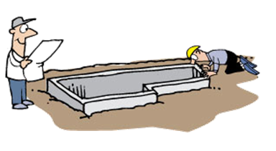
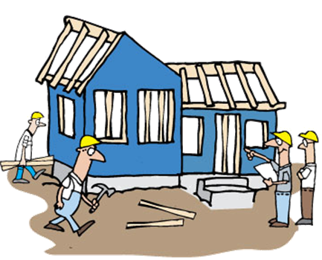

Quality is part of everything
Plan/Manage
LEGO
Dev
Fun
Core
Origins
Intro
Agenda
Notes:
Agile: Quality is a part of every step along the way
Concept: quality checked every step of the way
* Strip: Various stages of a house under construction, with workers checking work against plans, measuring carefully, testing strength and solidity;
* Frame: last frame shows plumber hooking bathroom plumbing to water main, happy/beaming, checking off a checkbox on a clipboard

Slide 4
Baked in?
Plan/Manage
LEGO
Dev
Fun
Core
Origins
Intro
Agenda

Slide 5
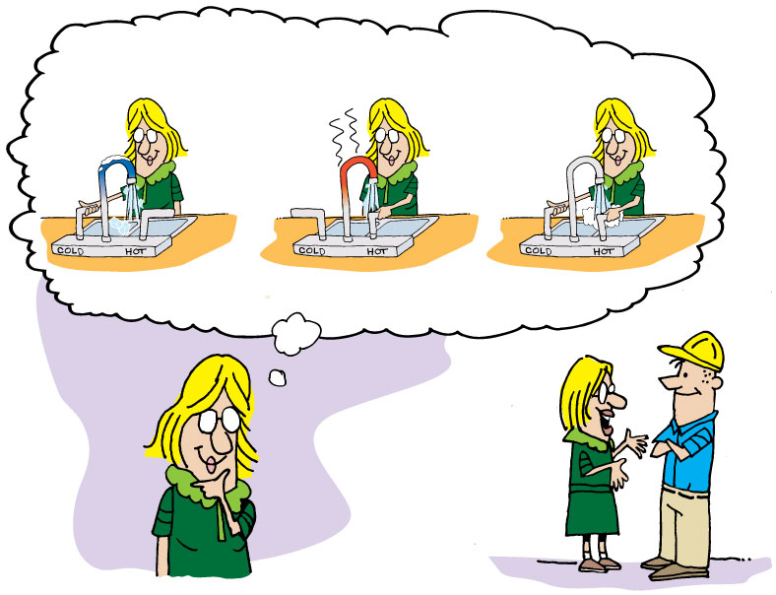
Acceptance criteria
Plan/Manage
LEGO
Dev
Fun
Core
Origins
Intro
Agenda
Notes:
Acceptance Testing
Concept: what the user (homeowner) had in mind
* Strip: Homeowner (woman), imagining single control kitchen sink faucet, with markings for hot and cold; turning on cold, showing it to be cold (maybe ice cubes coming out?); turning on hot, showing it to be hot (steam)?; turning to middle, showing warm (maybe washing hands?); talking to contractor, gesturing, previous imaginations showing
* Strip: Contractor, seeing finished work, considering; turning on hot, but cold comes out – big word FAIL; turning on cold, but hot comes out – big word FAIL; turning to middle, warm comes out – big word PASS

Slide 6

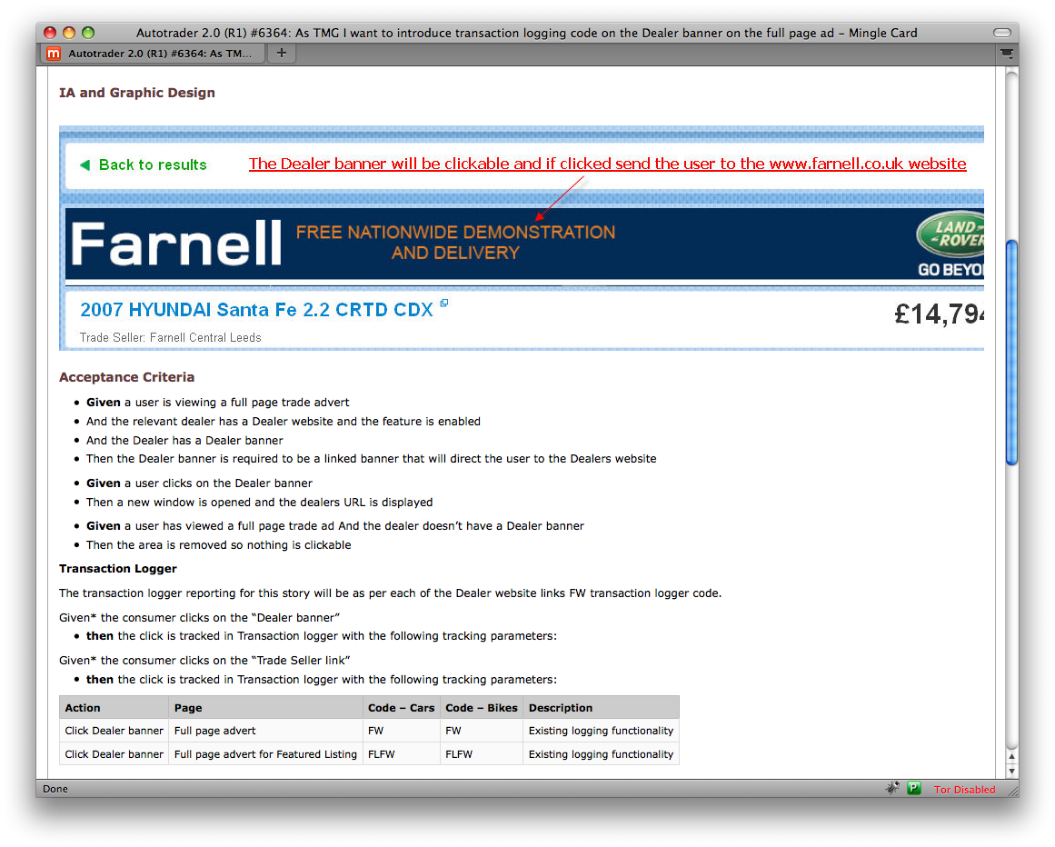
Plan/Manage
LEGO
Dev
Fun
Core
Origins
Intro
Agenda
Notes:
Given (When) Then – context, circumstances, expectations

Slide 7
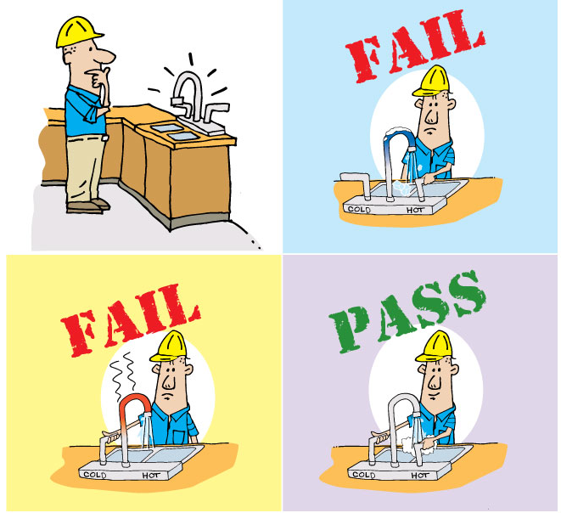
Am I done?
Plan/Manage
LEGO
Dev
Fun
Core
Origins
Intro
Agenda
Notes:
Acceptance Testing
Concept: what the user (homeowner) had in mind
* Strip: Homeowner (woman), imagining single control kitchen sink faucet, with markings for hot and cold; turning on cold, showing it to be cold (maybe ice cubes coming out?); turning on hot, showing it to be hot (steam)?; turning to middle, showing warm (maybe washing hands?); talking to contractor, gesturing, previous imaginations showing
* Strip: Contractor, seeing finished work, considering; turning on hot, but cold comes out – big word FAIL; turning on cold, but hot comes out – big word FAIL; turning to middle, warm comes out – big word PASS

Slide 8
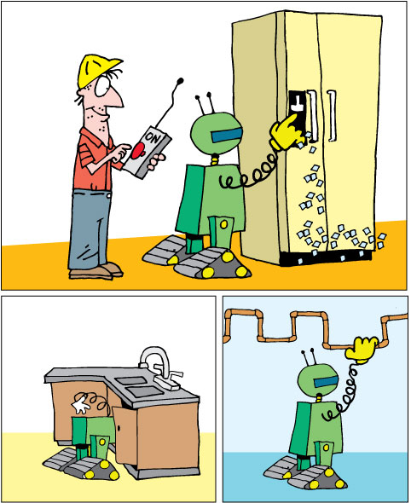
Automation
Doesn’t replace
manual testing
Plan/Manage
LEGO
Dev
Fun
Core
Origins
Intro
Agenda
Notes:
Automated Testing
Concept: tests are good, but not effective if they are manual – too time consuming and costly.
* Strip: Repeat of 7 (Regression Testing), b. We’ll talk about how long this takes, and how it’s dependent on the availability of the plumber and the homeowner.
* Strip: Con tractor pushing big ON button on a Robot; Robot testing icemaker, sink, other plumbing. Can be multiple frames, showing robot doing various tasks.
There needs to be a change made before we can show that the robot is coming and testing stuff to make sure that the change did not affect earlier functionality

Slide 9
Plan/Manage
LEGO
Dev
Fun
Core
Origins
Intro
Agenda
Notes:
About to talk about IntelliJ – set context

Slide 10
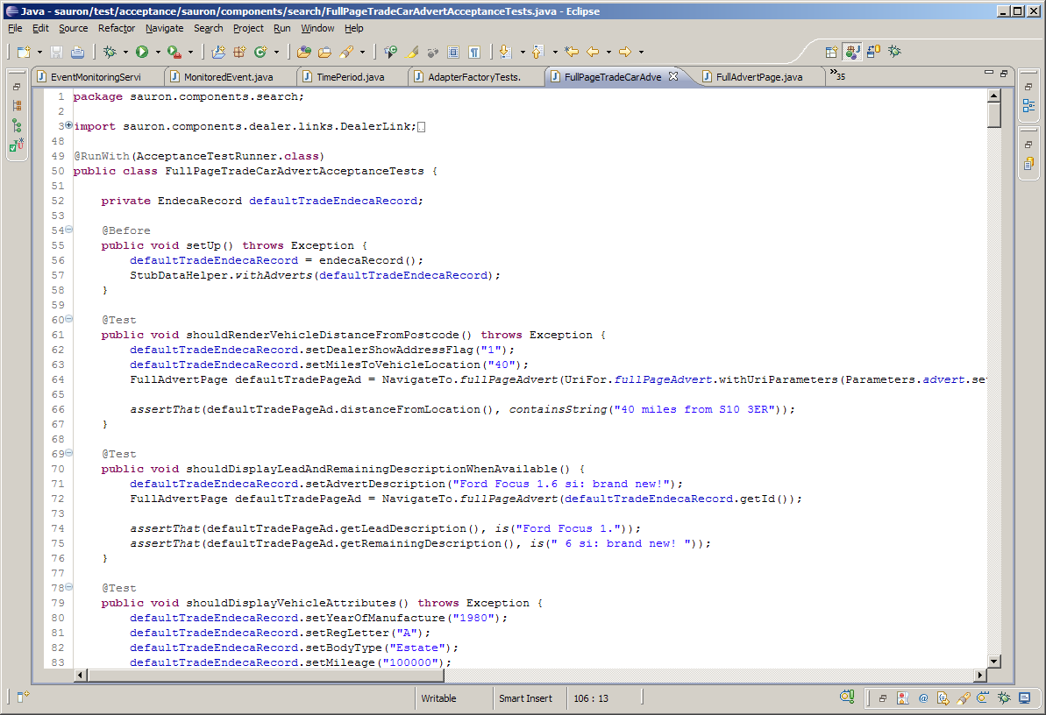
Plan/Manage
LEGO
Dev
Fun
Core
Origins
Intro
Agenda

Slide 11

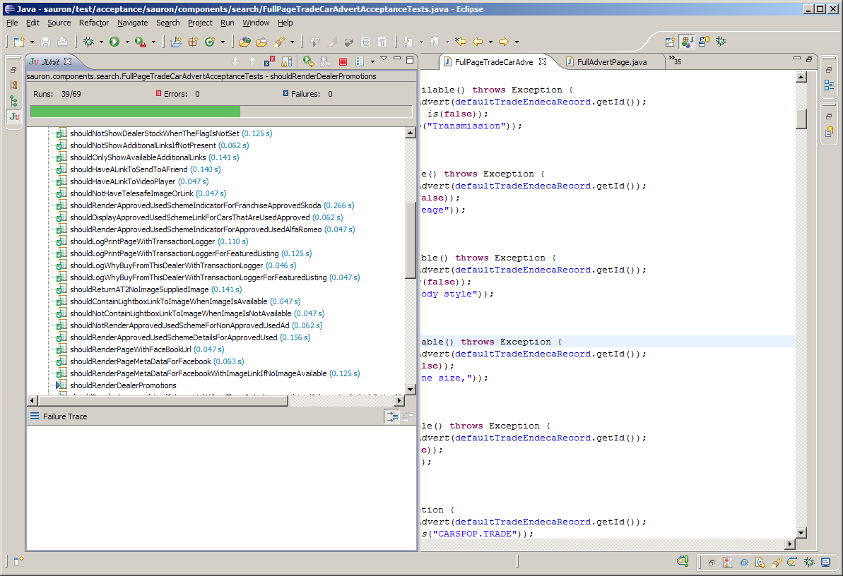
Plan/Manage
LEGO
Dev
Fun
Core
Origins
Intro
Agenda

Slide 12
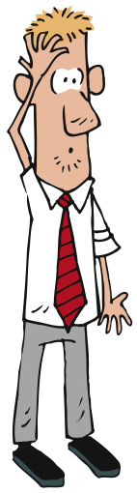
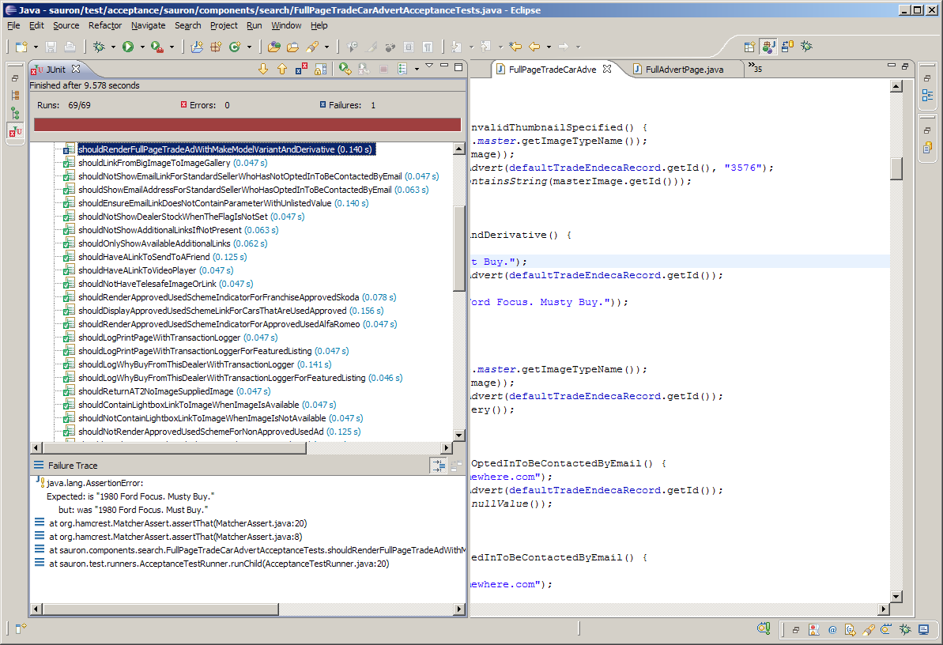
Plan/Manage
LEGO
Dev
Fun
Core
Origins
Intro
Agenda

Slide 13
Levels and types of testing
Plan/Manage
LEGO
Dev
Fun
Core
Origins
Intro
Agenda

Slide 14
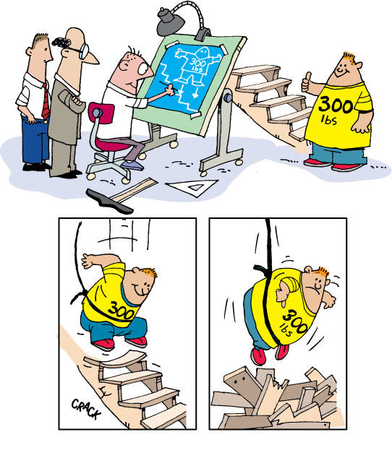
Unit Testing/TDD
Plan/Manage
LEGO
Dev
Fun
Core
Origins
Intro
Agenda
Notes:
Unit Testing/TDD
Concept: a specific component, checking quality
* Strip: architect/designer making drawing of large man jumping up and down on stairs, floors, etc – man has T-shirt saying “300 LBS”; contractor and workers, contractor pointing to drawing and T-shirt; 300 pound man, standing in area where stairs will be, looking around, giving thumbs up; 300 pound man jumping up and down at top of barely framed stairs, attached to bungee cord going up; stairs collapsing, man hanging, giving thumbs down
Talk about BDD/FDD/…?

Slide 15
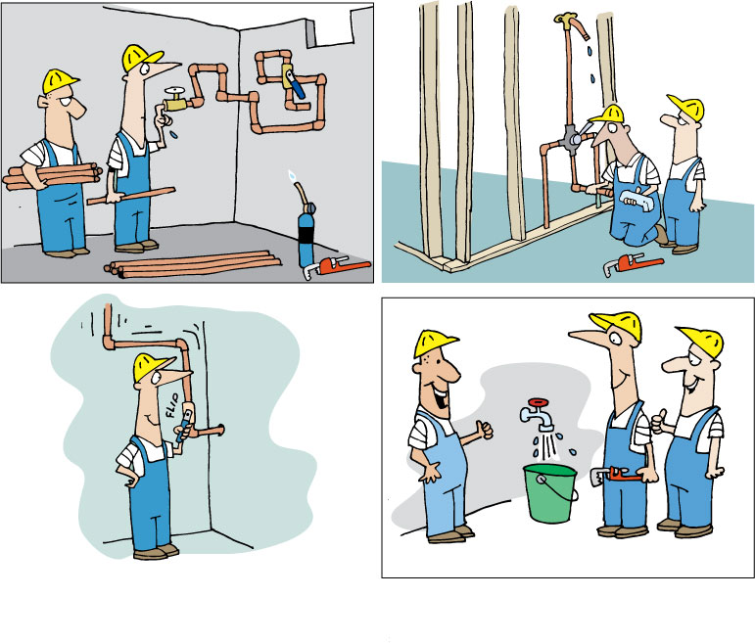
Functional Testing
Plan/Manage
LEGO
Dev
Fun
Core
Origins
Intro
Agenda
Notes:
Functional Testi ng
Concept: water and/or electricity
* Strip: Plumbers laying piping in foundation; plumbers attaching plumbing fixtures in framed house; plumber turning on faucet, somehow show water flowing through pipes; plumber watching water run out into bucket, beaming, thumbs up
I really liked the concept of illustrating QA ideas with practical real-life examples

Slide 16
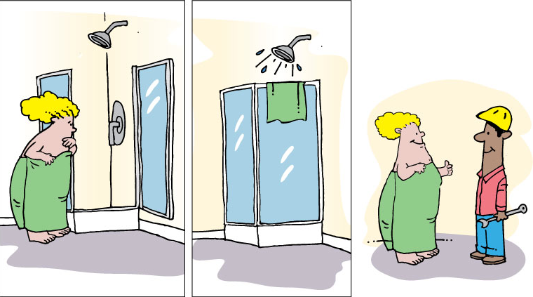
User Acceptance Testing
Plan/Manage
LEGO
Dev
Fun
Core
Origins
Intro
Agenda
Notes:
User Acceptance Testing
Concept: Someone, user or user advocate, does manual testing
* Strip: Woman inspecting shower stall; woman taking shower; woman giving contractors a thumbs-up (no nudity or anything risqué)

Slide 17
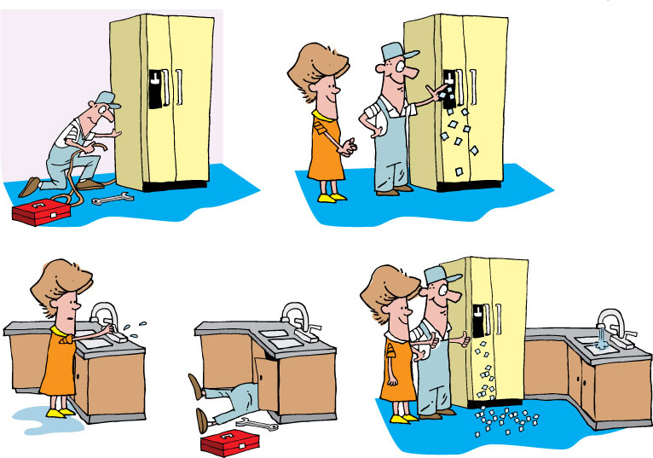
Regression Testing
Plan/Manage
LEGO
Dev
Fun
Core
Origins
Intro
Agenda
Notes:
Regression Testing
Concept: after changes, things that worked before should still work
* Strip: Contractor hooking up icemaker connection to water; Contractor showing homeowner ice cubes being made; Homeowner rechecking sink, fails; Plumber fixing water under sink; Homeowner checking ice maker and sink – all works – thumbs up

Slide 18
Testing Approach
Iteration 1
Iteration 2
Iteration 3
.....
Regression
UAT
Go live
Unit Testing
IntegrationTesting
Functional Testing
Acceptance Testing
Acceptance Testing
Acceptance Testing
Acceptance Testing
Performance Testing
Performance Testing
Regression – End to End Testing
Usability Testing
Regression – End to End Testing
Exploratory Testing
Exploratory Testing
Exploratory Testing
Exploratory Testing
Automated (Continuous Integrated)
Manual
Partially automated

Slide 19

Thank You
Copyright 2009 ThoughtWorks, Inc.
www.thoughtworks.com
Notes:
Thank you for joining us for The Origins of Agile Software Development, a module in Agile Fundamentals. The next module in the series is The Agile Core, in which we’ll explore some of the practices and methodologies that make Agile what it is.
Until the next time, we wish you well.

